Slide 1

MOVIE TICKET BOOKING
Project Mentor:-
Pooja Mehta
PROJECT MEMBERS:-
Batch No:-7471-2022
T. DIMPLE CHANDRIKA VEERASI
G.LAVANYA
G.SWATHI
T.LAVANYA
T.REKHA

Slide 2
CONTENTS
ABSTRACT
OBJECTIVE
INTRODUCTION
MODULE
ANNOTATION
VALIDATION
SPRING BOOT
MY SQL
POSTMAN
MAPPING DIAGRAMS
ER DIAGRAMS
OUT PUT SCREENS
CONCLUSION

Slide 3
ABSTRACT
movie ticket booking is basically made for providing the customers an anytime and anywhere service for booking cinema tickets and providing information about the movies and their schedule online.
Using spring tool for backend services we propose to develop an application that can create, read, update and delete (CRUD) operations on theatres, movies and retrieve movie details based on theatres.
In this application we intend to use MySQL as our database, Java with spring tool for backend development Framework.
We intend to use tools like postman that are used in the industry for API testing.This system is basically aimed to provide complete information of the movie and schedule to the customer, according to which he can book the tickets.
Keywords: Spring tool, MySQL, Postman.

Slide 4
OBJECTIVE
Manipulate the data about movies, and the cities and theatres where they are being released and screened.
Manage data of users and buyers who bought tickets to facilitate bookings in the future.
The system collects details about the users who are interacting with the system to make the process of booking a movie ticket faster..
The administrator can keep track of the screenings of movies taking place and also the movies themselves. The user can look for tickets for a movie and purchase them, after logging in.

Slide 5
INTRODUCTION
Movie Ticket Booking System has been developed to override the problems of existing manual system.
Every organization, whether it is big or small has challenges to overcome and managing the information of Movie, Payment, Booking, city, theatre etc.
This website is supported to eliminate and in some cases reduce the hardships faced by this existing offline system. Moreover this system is designed to carry out the particular operations in a smooth and effective manner.
The application is reduced as much as possible to avoid errors while entering the data. It also provides error message while entering invalid data.
No formal or prior knowledge is needed for the user to use this system. Thus by this all it proves it is user-friendly.
Movie Ticket Booking System as described above can lead to error free, secure, reliable and fast management system. It can assist the user to concentrate on their other activities rather to concentrate on the record keeping.
Thus it will help organization in better utilization of resources.

Slide 6
MODULE USED
Entity:-
The entities are the persistence objects stores as a record in the database
Persistence Unit: It defines a set of all entity classes. In an application, EntityManager instances manage it.
The set of entity classes represents the data contained within a single data store.
Service:-
It is used with classes that provide basic functionalities.
Repository:-
Spring boot framework provides us repository which is responsible to perform various operations on the object.
Repository classes are auto detected by spring framework through classpath scanning.

Slide 7
Controller:-
A controller class is normally a class part of the Model View Controller (MVC) pattern. A controller basically controls the flow of the data. It controls the data flow into model object and updates the view whenever data changes.

Slide 8
ANNOTATION
ANNOTATION | DEFINITION
@ID | Indicating the member field below is the primary key of the current entity.
@ENTITY | The @Entity annotation specifies that the class is an entity and is mapped to a database table.
@COLOUM | @Column annotation is used for Adding the column the name in the table of a particular MySQL database
@JOIN COLOUM | @Join coloum Specifies a column for joining an entity association or element collection.
@GENERATED VALUE | Provides for the specification of generation strategies for the values of primary keys.
@REST CONTROLLER | This annotation is used at the class level and allows the class to handle the requests made by the client.
@SERVICE | It is used to mark the class as a service provider

Slide 9
ANNOTATION | DEFINITION
@AUTOWIRED | provides more fine-grained control over where and how autowiring should be accomplished.
@REPOSITORY | Used to indicate that the class provides the mechanism for storage, retrieval, search, update and delete operation on objects.
@CONTROLLER | Indicates that a particular class serves the role of a controller.
@REQUEST MAPPING | The @RequestMapping annotation can be applied to class-level and/or method-level in a controller.
@PATH VARIABLE | The @PathVariable annotation is used to extract the value from the URI.
@REQUEST BODY | The @RequestMapping annotation can be applied to class-level and/or method-level in a controller

Slide 10
ANNOTION | DEFINITION
@GET MAPPING | The @GetMapping annotation is a specialized version of @RequestMapping annotation that acts as a shortcut for @RequestMapping(method = RequestMethod. GET) .
@POST MAPPING | @PostMapping is a composed annotation that acts as a shortcut for @RequestMapping(method = RequestMethod. POST)
@PUT MAPPING | As we know PUT HTTP method is used to update/modify the resource so the @PutMapping annotation is used for mapping HTTP PUT requests onto specific handler methods.
@DELETE MAPPING | Annotation for mapping HTTP DELETE requests onto specific handler methods. Specifically, @DeleteMapping is a composed annotation that acts as a shortcut for @RequestMapping(method = RequestMethod. DELETE) .

Slide 11
VALIDATION
@NOTEMPTY :- NotEmpty() is a static method of the Validate class that is used to check whether the given argument array/map/collection/character sequence is not null or empty.
@valid :- Valid annotation is a class level annotation that can validate parameters that are passed into method of the annotated class

Slide 12
BACKEND USED SPRING BOOT :-
Spring Boot makes it easy to create stand-alone, production-grade Spring based Applications that you can "just run".
We take an opinionated view of the Spring platform and third-party libraries so you can get started with minimum fuss. Most Spring Boot applications need minimal Spring configuration.
Spring Boot is a java framework used for develop standalone application. Need strong knowledge in OOPS & Java concept then only working with spring framework Mostly all applications are developed by spring boot.

Slide 13
MY SQL:-
MySQL creates a database for storing and manipulating data, defining the relationship of each table. Clients can make requests by typing specific SQL statements on MySQL. The server application will respond with the requested information and it will appear on the clients' side.
POSTMAN:-
Postman is an application that allows us to test APIs utilizing a graphical user interface. Some of Postman's advantages include the collection feature and the possibility to create different testing environments. Postman is a user-friendly tool that helps us optimize our time when executing tests.

Slide 14
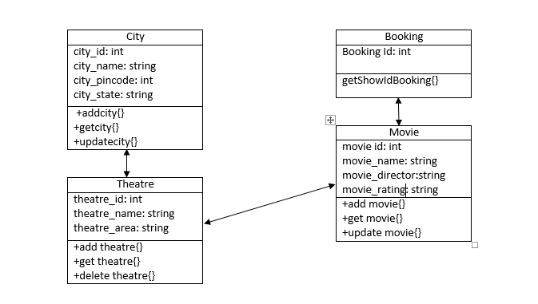
MAPPING DIAGRAMS

Slide 15
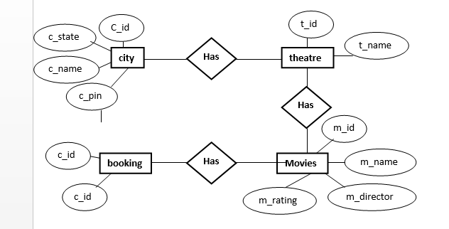
ER DIAGRAMS

Slide 16
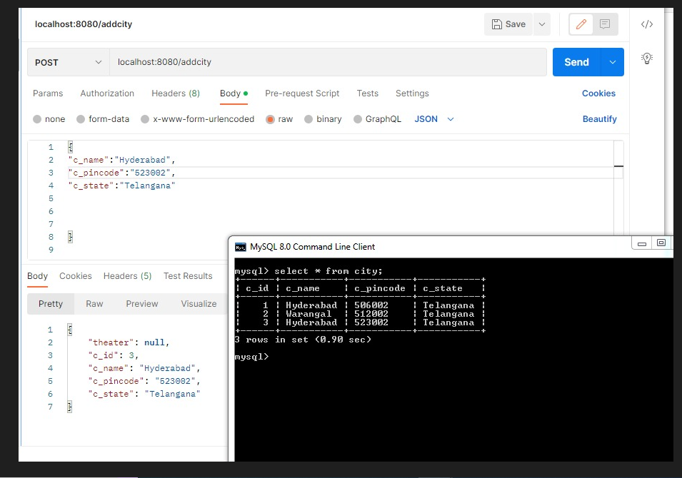
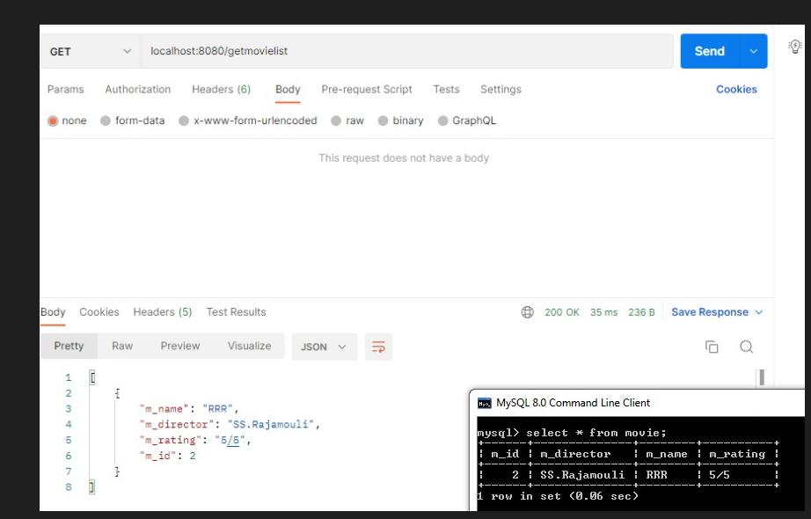
OUTPUT SCREENS

Slide 17
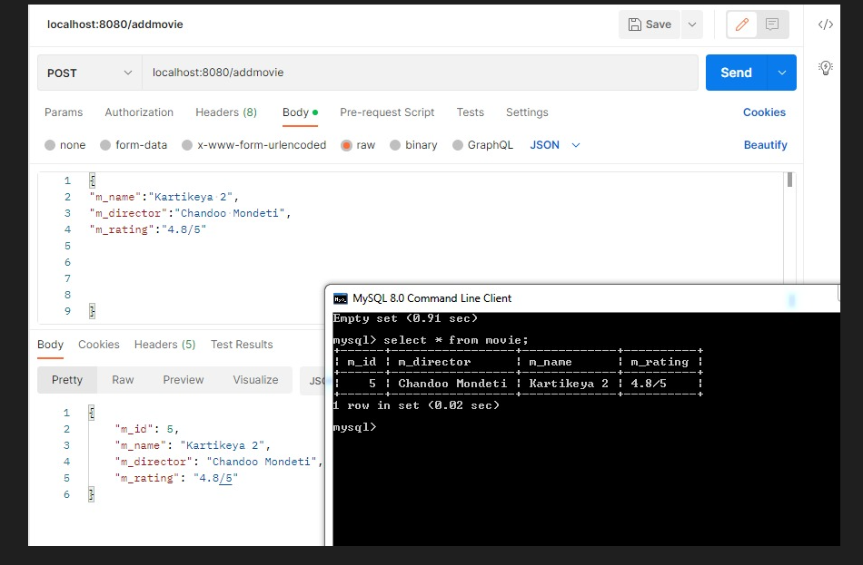

Slide 18
CONCLUSION
This project is designed to meet the requirements of a movie ticket booking application. We have designed the project to provide the user with easy retrieval of data, details of theatre and necessary feedback as much as possible.
The system has been developed with much care and free of errors and at the same time it is efficient and less time consuming. The administrator dashboard is provided to add new movies, theatres, and are generally maintained by administrators.
The Customer will be able to select his/her desired movie, from the available theatres and book the ticket for the movie.

Slide 19
THANK YOU!

